Slide 1

Writing Your American-Style Resume
Tips for International Students
Notes:
Total time: ~8minutes

Slide 2





DESCRIPTION:
Learn how to evaluate the effectiveness of your current resume in preparation for developing or revamping your American-Style Resume
Notes:
This module is specifically for international students who want to learn how to write an American Style resume or who want to adapt their current CV to an American resume.
The information in this module augments and does not repeat the information in our other resume modules. Therefore, it is important that you view the Resume Modules for all students to be certain you receive more in depth information on writing your strongest, most competitive resume.

Slide 3

Learning Outcomes
Be more confident in creating an American-Style resume, even if you do not have extensive paid experience
Understand what information is not on a resume
Learn about key resources for international students at Career Development.
Notes:
After completing this module, you will:
Increase your understanding of what can be included in your American-Style resume, even if you do not have extensive paid experience.
Understand what information is not on an American-style resume, even if that information IS on a CV.
Learn about key resources for international students on our Career Development website which are designed to assist you in achieving your goals.

Slide 4

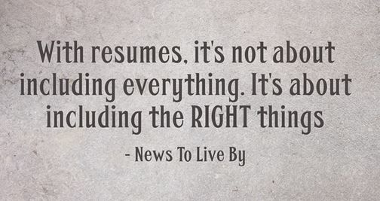
Resumes By The Numbers……
76%
Of Resumes are Ignored if Your Email Address is Unprofessional. http://theundercoverrecruiter.com/infographic-recruiters-spend-5-7-seconds-reading-your-cv/
84%
Of Employers indicate your resume should be 1 page if you have less than 5 years of experience. http://theundercoverrecruiter.com/infographic-recruiters-spend-5-7-seconds-reading-your-cv/
88%
Job Rejection Rate if you include a Photo on your resume http://blog.employmentguide.com
Notes:
There’s a great saying in the U.S. that many of you might have in your home country as well: You don’t get a second chance to make a first impression”.
Unlike many other countries, the American resume is really a marketing document. It is a way to briefly showcase your skills and experiences that relate to the specific jobs you are applying for. Think of it as you are selling a product (you) and your resume is your marketing and advertising piece.
You won’t market yourself well if your resume contains spelling mistakes, uses poor grammar, or doesn’t follow the standard American-Style resume format. It is important that you view the resume modules for all students so you can learn how to format your resume correctly with a well-written heading, education, and experience section. Also, the supplemental materials at the end of this module contain examples to help you write these sections of your resume.
To begin with, your E-mail address should be professional and employer ready: 76% of resumes are ignored if the email address is unprofessional! You’ll look more professional if you use your northeastern email address. email addresses like scubagirl@ or iloveorangeisthenewblack@gmail.com should be avoided.
84% of employers believe your resume should be 1 page. Anything more and they may not read it. As a general rule, you can use a second page for a resume for every ten years of experience. However, you don’t need to list more than 15 years of experience on a resume. Remember, a resume is not a complete history of your work, skills, and activities, but highlights your qualifications that are most related to the positions you’re applying to. Having your resume on one page (or two pages if you have 5-10 years or more of experience) means you’re not including everything but are targeting only the most critical information.
Use a resume that is not generic but rather targeted and edited for each specific job for the best success. Right or Wrong, that’s the mindset of the employer. Use that understanding to your advantage.
Want to include a photo? Don’t. 88% of employers reject candidates with photos on their resumes. A photo is only necessary for jobs like modeling or TV anchor where seeing your photo is critical to the actual job.
(http://www.infographicszone.com/resume-2/mistakes-that-you-should-avoid-in-cv-infographics)
http://www.buzzquotes.com/skills-quotes-for-resume for News to Live By (for the With Resumes quote below by News To Live By)

Slide 5

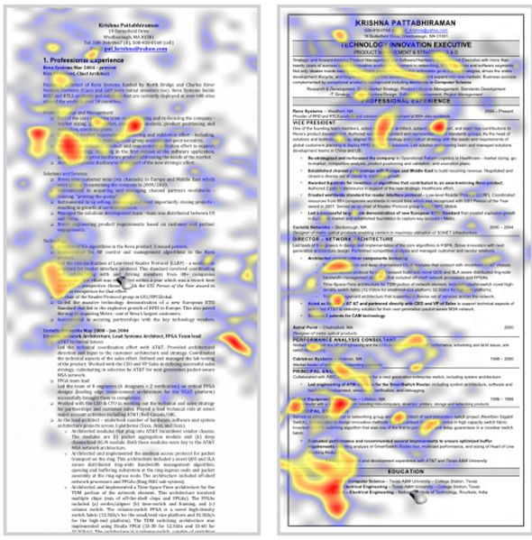
The First 6 Seconds:
What Does the Employer Read?
Notes:
There was a very interesting study by TheLadders which showed how 30 professional recruiters looked at resumes through a technique called “eye tracking”. Over the course of 10 weeks, their eye movements were recorded and analyzed in order to identify what recruiters spend the most time looking at on resumes. A “heat map” of their eye movements was used to see which resumes they spent longer on.
Can you guess which of these 2 resumes they spent more time reviewing? If you guessed the one on the right hand side you’re absolutely right.
Why? It’s easier to read and the format allows you to clearly see information like skills and experience.
Other reasons include the fact that recruiters want to be able to easily find your name, your most recent two positions including start and end dates, titles, and company, and they’re also interested in quickly locating your educational information.
(citation: http://www.businessinsider.com/heres-what-recruiters-look-at-during-the-6-seconds-they-spend-on-your-resume-2012-4#ixzz3hlHOq8UH)
Did you also notice on the second resume that the heat map is focused more on the left side of the resume than on the right side? Because Americans read left to right, you’ll want to start your bullets in your experience section with a verb and an achievement on the left and then follow this with how you obtained that achievement to the right of your bullet.
So what does this all mean for you? We call it the 20 Second glance, which is sometimes as little as 6 seconds in everyday practice. This is how long a recruiter takes to look at your resume before they decide whether to move on, keep it, or read it more thoroughly. So, you have to make sure your most important and relevant experience is in the top 1/3 of the resume, as well as making sure that it’s error free, and easy to read. A well-crafted, targeted and error free resume equals a higher chance for an interview.

Slide 6
What’s Not On an American Resume?
Gender
Birthdate
Family’s occupation
Marital Status
Citizenship/Ethnicity
No Graphics, Grids, Tables, or Templates…
Notes:
What’s else should not be included on an American resume? Don’t include marital status, gender, birthdate, family’s occupation, citizenship/ethnicity.
No Sentences are used on American resumes. Instead, use phrases with strong action verbs that contain results and accomplishments. See the Resume modules for all students and the additional resources for more information and examples.
Also, Do not use abbreviations or graphics, tables and headers/footers as Most Applicant Tracking software won't be able to pick up the information.
(http://www.infographicszone.com/resume-2/mistakes-that-you-should-avoid-in-cv-infographics

Slide 7


You have more experience than you think………
Professional Experience
Co-op or Internships
Consulting-
Paid or Unpaid
Shadowing/Observing at a Company
Volunteer Experiences
http://www.englishwithimpact.com/small-talk-work-conversation/
Notes:
Everyone knows that professional and coop/internship experience should be on a resume, but what if you don’t have this type of experience?
Experience doesn’t just mean professional, full-time work experience.
Did you go into work with a relative or friend and observe them for the day? That can be written up as experience!
Did you help a business and they utilized your ideas but you weren’t technically an employee? You can definitely write that up as experience. Just be sure, if you did this in the U.S., that you were in legal status. If you did it in your home country, you should and can definitely include it!
Take the first step by creating a self-inventory of past experiences:
Professors you have helped
Student organizations in which you have a leadership role
Professional Associations you belong to
Meetup groups you’ve organized—especially if it’s around a professional interest
linkedIn groups or social media you help a professor or others with
These can provide you with ideas of good information to include in the Experience section of your resume.

Slide 8

You Can Also Include These Activities……..
Professional Association Activities
Volunteer Activities
Academic Projects
Leadership Activities
www.pixabay.com
Notes:
When writing your experience section, you can also include Academic Projects, Volunteer Activities, Leadership activities, plus summer or other jobs. Many people don’t realize that these can be listed as experiences for your resume.
Remember to list:
Dates
Location
Job or position title (if applicable)
Skills you utilized in position/experience
For many graduate students, academic projects are a terrific way to showcase the new skills you are learning in your degree program. Examples for how to put Academic Projects on your resume are in the Additional resources section.
If you don’t have a lot of experience yet-Think about the story you want to be able to tell an employer when you apply for jobs – and then seek opportunities to support your goals early and throughout your program.

Slide 9
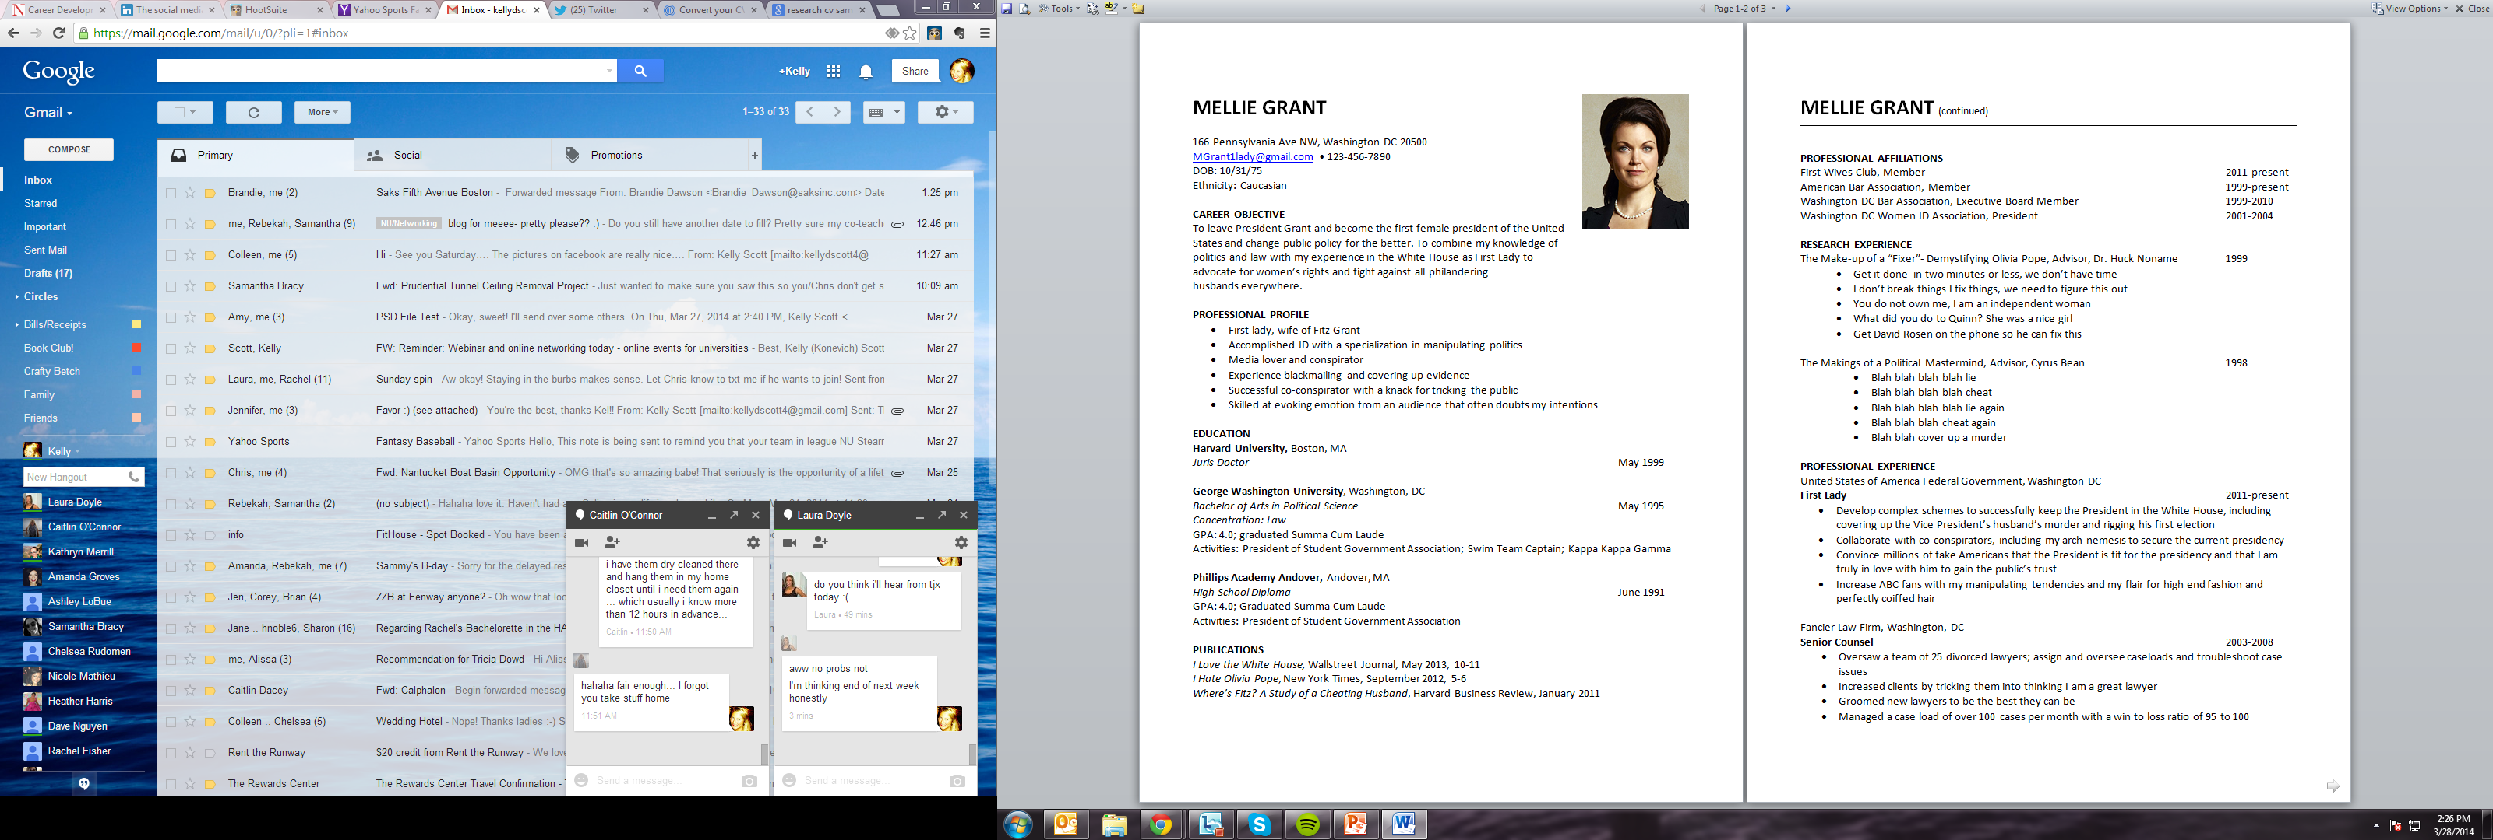
Notes:
So let’s test your knowledge. This sample “CV” of Mellie, a character on Scandal, is two pages long. What would you cut out?
If you decided you can cut out any of the following you’re absolutely right and are well on your way to creating your American-style resume. Here’s what you can delete from this resume:
Mellie’s Picture, Date of Birth, Ethnicity/Race, and high school!
Publications and Research are only listed if relevant or if you don’t have additional experience.
As a General rule- nothing older than 10 -15 years for experience is listed—so she doesn’t need to list anything before Senior Counsel role.
you would not list a Career Objective and you would only list a Skills Summary/Career Summary or Professional Profile if you were customizing it for each job you were applying for.

Slide 10
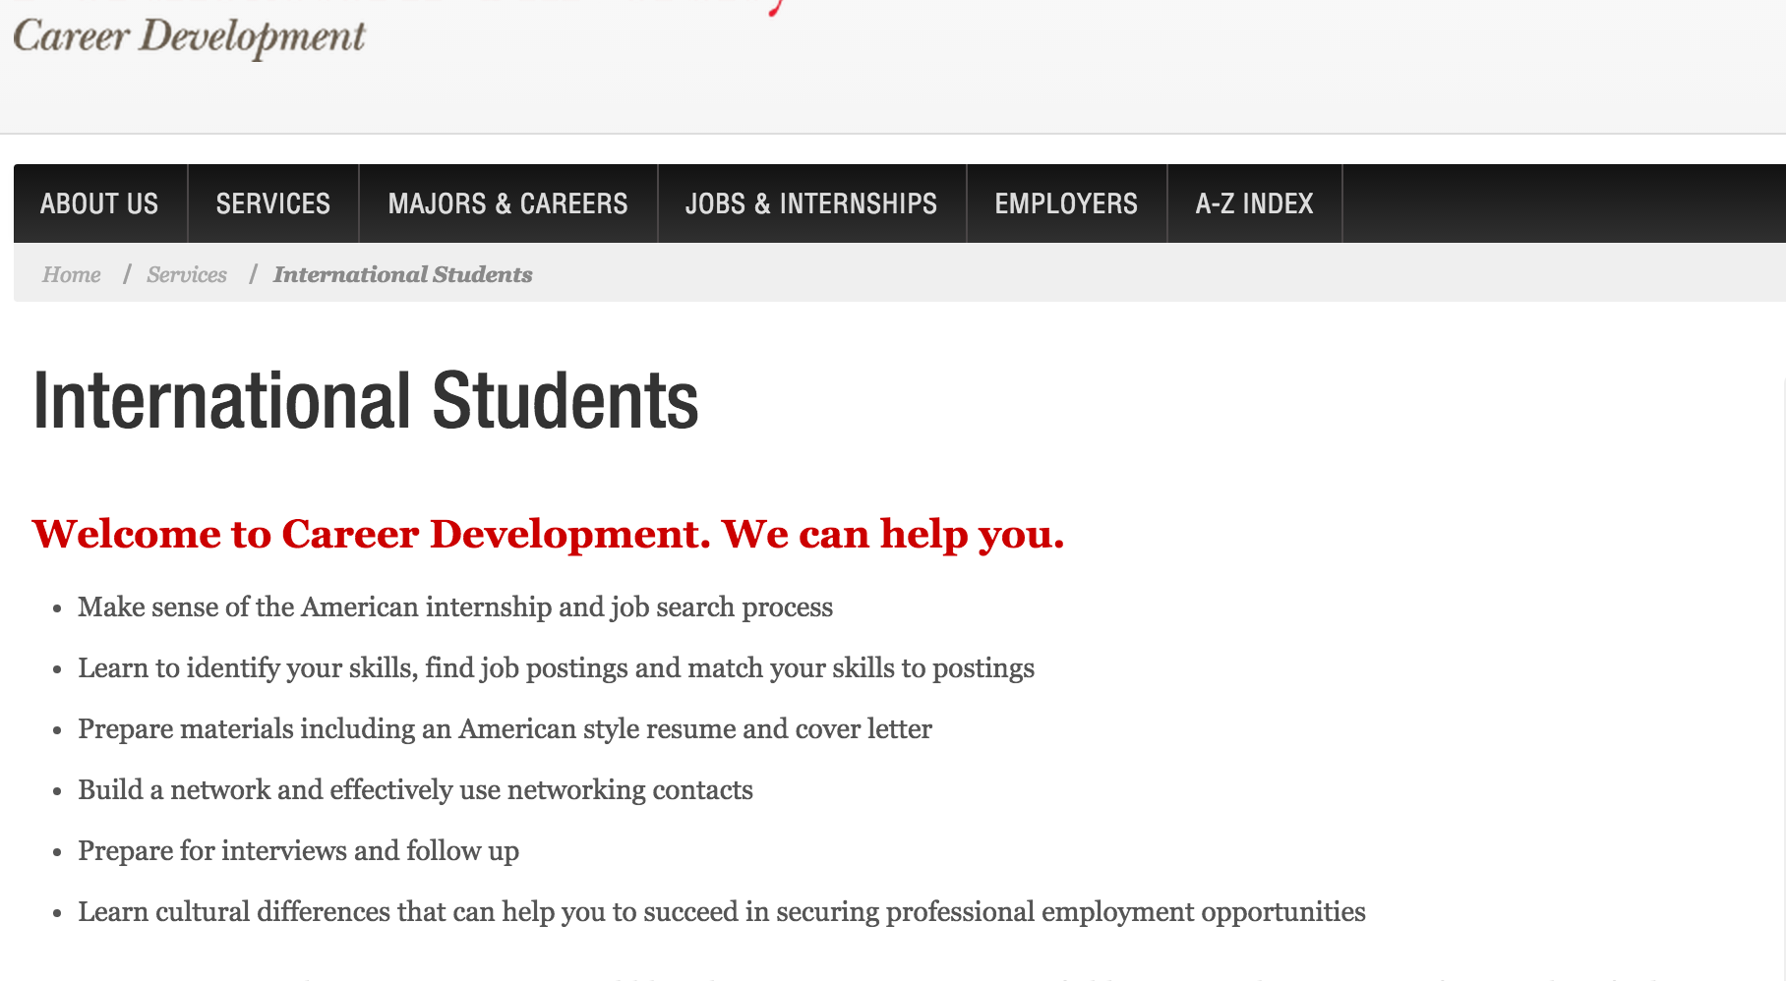
International Student Resources Available via Career Development
Notes:
You’ve already built success by moving to a new culture and studying in a language that is not your native language. Take advantage of Northeastern’s resources specifically for international students on our Career Development website during your degree program to help you build on your current success.
Here’s what our page of international student resources includes:
Resources on learning which companies have hired international students on H-1B visas
Resources on practicing or strengthening your American-style English and voice articulation, including courses you can take at Northeastern
Blogs and other resources to learn more about American culture, including work culture, and ideas for getting involved at Northeastern in activities like community service or teaching your language to an American speaker which you can put on your resume!
What are your next steps? – There are additional resources in the slides below, full of sample sections or sample resumes.
After creating your American-Style Resume take advantage of our Skype walk-ins or schedule an appointment with Career Development through your My neu.
Remember to always keep your goals in front of you!
Be sure to check out the Career Development website for webinars and schedule a skype or telephone appointment with an advisor early on to make the most of your experience.

Slide 11
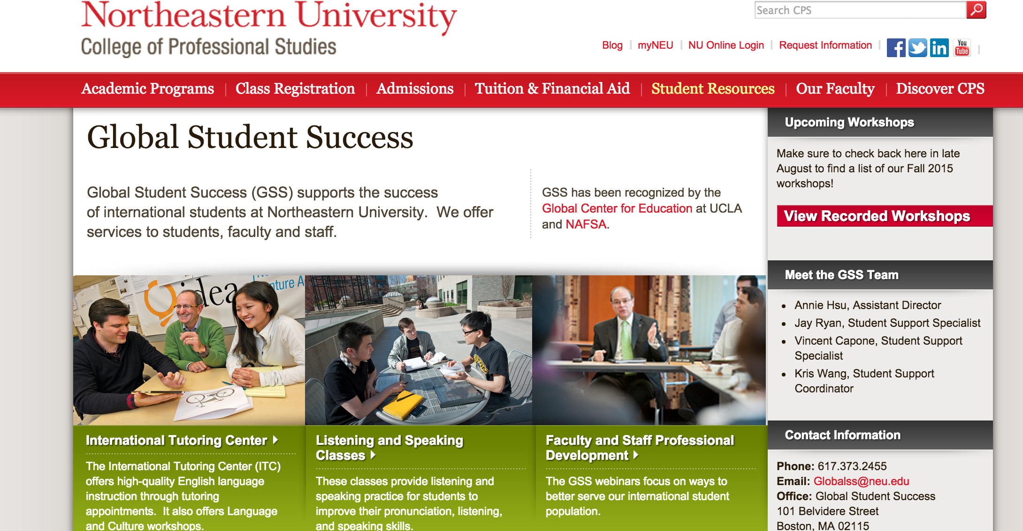
International Student Resources Available via Global Student Success
Notes:
Additionally, Northeastern has an office of Global Student Success – that can provide you with high-quality language, academic and cultural support. Appointments can be made remotely or in person.
The International Tutoring Center provides free, high quality English language and support in the areas of writing, conversation, pronunciation, reading, TOEFL, and career prep. Culture and language courses are also offered.
Listening and Speaking Classes are also available to helpyou impove probunciation, listening and speaking skills.
Additionally – previously recorded workshops can also be viewed and cover topics such
You can book in person or virtual appointments with a member of the advising team via my NEU,

Slide 12

Questions? Contact Career Development
Notes:
Supplement page to refer them to Big Interview, or make an appointment for a mock interview with a career counselor

Slide 13
DO not record past this point, supplmental resources

Slide 14

Supplemental Resources
A
Action Steps—Review Resume Resources including Action Verbs
C
Contact Information -Sample
E
Education & Experience, plus Academic Projects - Samples
S
Sample Resumes—First Resume, Entry Level, and Experienced
Ace Creating Your American-Style Resume!

Slide 15
ACTION STEPS
Notes:
So we’ve covered some great information about Developing Your Strongest American-Style Resume!
Here are some great resources and action steps:
Review the Full Resume Guide and select action verbs for your resume to see which experiences they relate to: http://www.northeastern.edu/careers/wp-content/uploads/2013/11/Resume-Guide-B1.pdf
2. Review Sample Resumes: http://www.northeastern.edu/careers/jobs-internships/resumes/
3. Revise your draft based on any new information you learned
4. Finally- Have your resume reviewed by either participating in skype walk-ins if possible or arranging an skype or phone appointment.

Slide 16
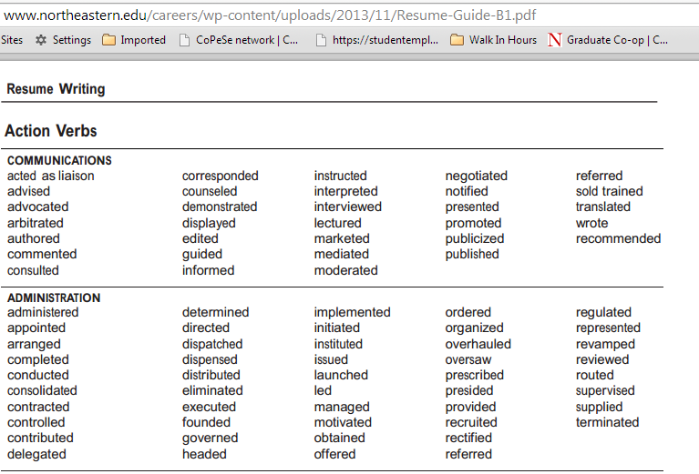
Resume Writing: Action Verbs
Notes:
Here is a resume writing action verbs list that is part of the resume guide on our career development website.
You’ll notice the action verbs are grouped in different categories, so please refer to a grouping to help you choose the right word for the resume.
Remember the Resume Modules for all students emphasized the importance of being results-oriented and/or quantifying in your descriptions.

Slide 17
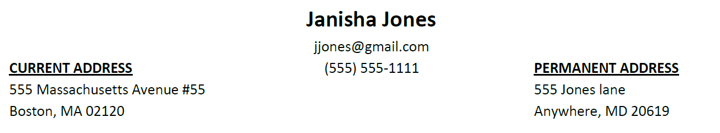

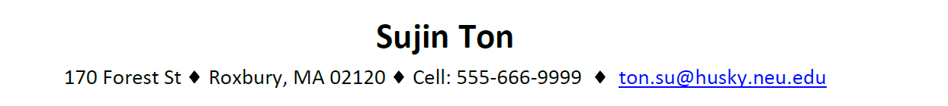
Samples: Contact Information
Notes:
As you can see from the examples on the slide, there is no one way to create your contact information heading. Feel free to choose what works best for you.

Slide 18
Samples: Education
Notes:
Some information you can have in your education section:
University name & location (current first)
Major and Degree
GPA (>3.0)
Honors/Awards (Dean’s List, Honor Societies and any scholarships you’ve received)
Relevant Coursework- either electives or courses that are extremely relevant to the positions you are applying to
Study Abroad
Again, the most important information goes first under this category.

Slide 19
More Samples: Education
Northeastern University, Boston, MA May 2011
Master of Science in Leadership
Dean’s List, GPA: 3.4
Or…
Northeastern University Boston, MA
Master of Science in Leadership, GPA: 3.4 May 2011
Honors: Dean’s List
Notes:
Notice that the bolding, the italicizing and where the location is different in both samples. However, both of these samples are right—it is a personal choice, but make sure that the rest of your resume is consistent with the choices you’ve made here. For example, if you have the location on the right above the date, make sure that the rest of your resume follows this format.

Slide 20

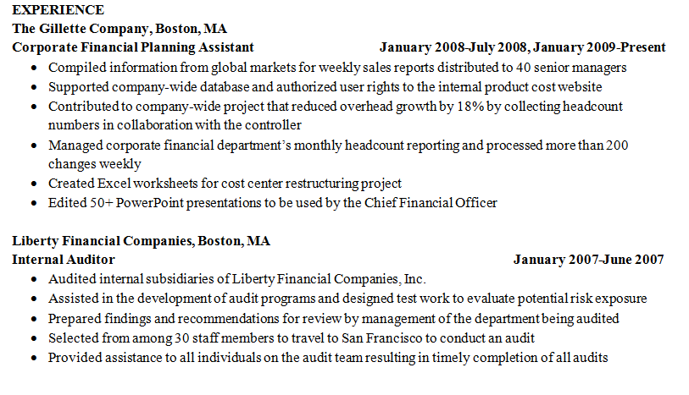

Sample: EXPERIENCE

Slide 21
Before & After: Experience
Before:
Smithson, Inc Boston, MA
Account Representative Jan. – June 2011
Solicited customers over the phone in order to contribute to overall company revenue. Handles leads, completed weekly report, trained new employees on sales procedures.
After:
Smithson, INC. Boston, MA
Account Representative Jan. – June 2011
Sold office supplies to a variety of New England businesses for this innovative, high energy organization
Increased sales in assigned territory by 12.5%
Generated leads and maintained over 30 accounts
Produced weekly sales and forecasting report using Lotus 1, 2, 3
Developed strong product assessment and presentation skills
Trained 8 new account representatives
Notes:
Why is the After better than the before description?
The description is in bullets
The action verbs in the after are a lot stronger than in the before
The after quantifies by putting in numbers
Better represents results of this individual’s efforts

Slide 22
More Samples: Experience
Notes:
Here’s an example experience. I want you to notice a couple of things:
A sample work experience has the name of the company, location, dates that an individual worked at the company, and bullet points that describe the experience. In the next slide, we’ll go over how to describe your experience.

Slide 23
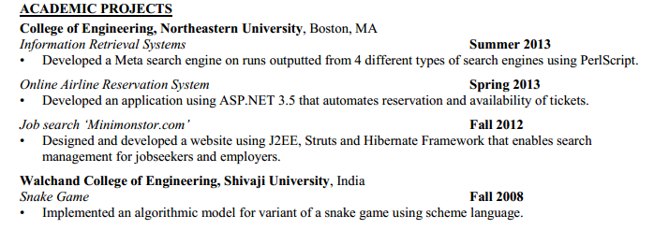
Sample: Academic Projects
Notes:
Make sure it’s easy to read, and that they know what university you did the project at.
If you did this for a corporate client, it’s great to list it but be sure to list the university as well.
Remember to use the key words you’re seeing in the job or co-op description, if that applies, and remember that you still need to use action skills.

Slide 24

Sample First Resume Before Doing Related Academic or Experiential Learning, including Projects, Consulting, Co-op, or Internships

Slide 25
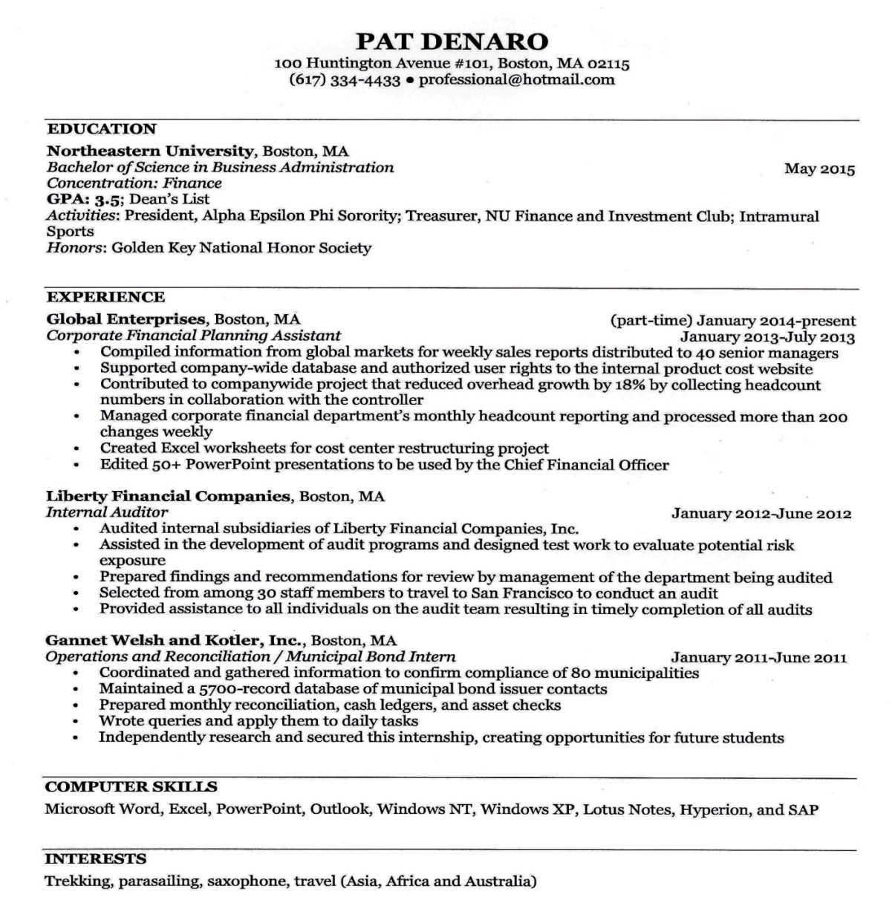
Entry Level Resume Sample
http://www.northeastern.edu/careers/wp-content/uploads/2012/08/Graduating-Senior-Resume-Samples-Final-for-web.pdf
Notes:
http://www.northeastern.edu/careers/wp-content/uploads/2012/08/Graduating-Senior-Resume-Samples-Final-for-web.pdf

Slide 26
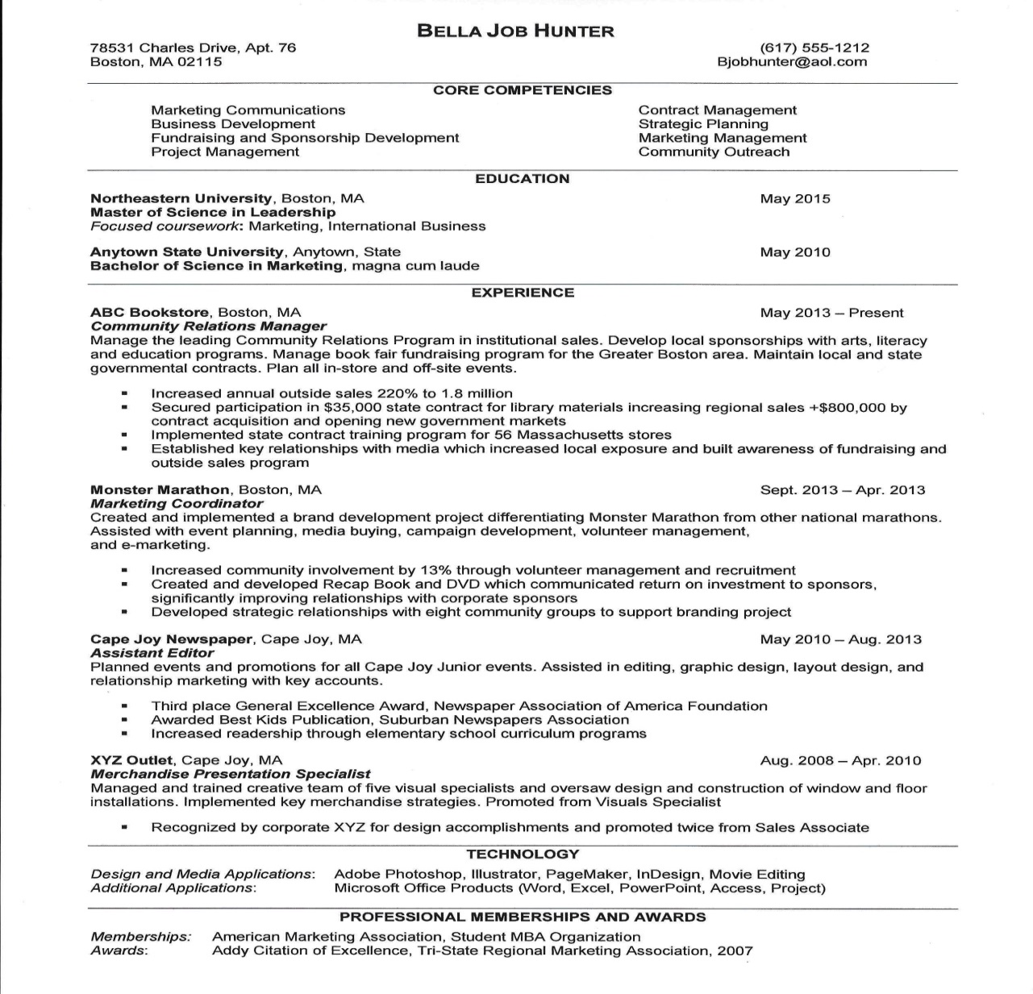
Experienced Sample
http://www.northeastern.edu/careers/wp-content/uploads/2012/08/Graduate-Student-Resume-samples-final-for-web1.pdf

