Slide 1

Marketing Your Global Experience
Ali Salinger & Diana Ghattas-Antony, Career Advisors
Notes:
Diana-
Welcome and thank you for coming. We are excited to have you here! What we hope to cover today is how to market your global experience in your resume and in your interview preparation. We have (INTRODUCE) with us to share their experiences and perspectives with you along with myself and Ali.
Next slide: Session Agenda
Timing 1.5 hours:
9-9:05 Welcome and Student Perspective (5 min - 2 student)
9:05 – 9:30 CD information - Resume & Interview (25 mins)
9:30 – 9:35 Break out: Identifying Skills Activity & Resume reflection (5 min)
9:35 – 9:55 Employer Perspective (20 min)
9:55 – 10:05 Break out: Mock Interview (10 min)
10:05 – 10:10 Close (5 min)
10:10-10:30 Q&A with Staff, Employer and Students

Slide 2

Future of Work = Careering for Life
Career mobility is
the new normal.
Your path may take
many turns…
Learn how to be in the driver’s seat by being :
Proactive
Intentional
Agile
You will change jobs often (one estimate: 12-14 jobs by age 38!)
You may also switch sectors (business, gov’t, nonprofit)
You may end up in jobs that currently do not exist
Start-ups are common
By 2025 the gig economy could be 43% of workforce
Notes:
Diana
Notes:
Many of these changes are driven by the rise of artificial intelligence (AI) and new technologies that render some jobs or industries obsolete even as they create new opportunities:
As such, in today’s economy, “career” is no longer a noun. It’s a verb –you will be careering for life! With a growth mindset it can be a joyful and exciting ride, even when the turns are unpredictable!
This is why it’s so important to be self-directed in your career management – with all of life’s turns, we want YOU to be in the driver’s seat!
The Career Design team is here to help you navigate your journey. We will teach you a process of lifelong learning and the ability to pivot to new opportunities as they arise.

Slide 3
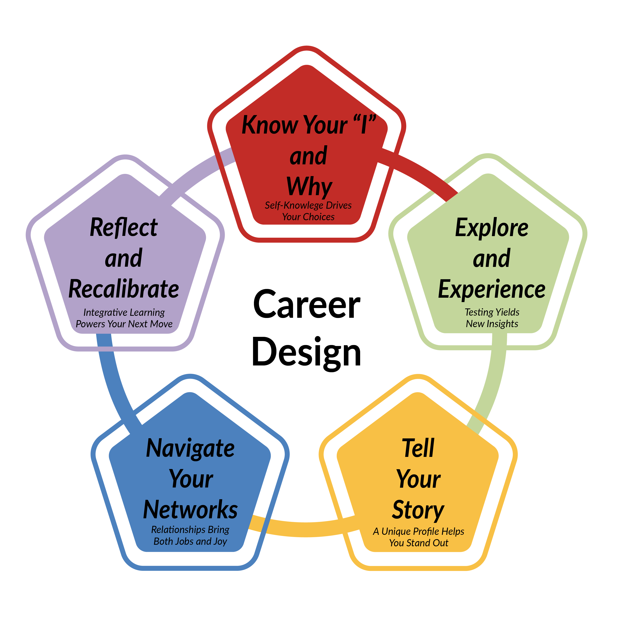
Career Design is
Lifelong Learning
Notes:
Ali
Notes: Since you’ll be careering for life, you need a good process to respond to change and determine your next step. Design thinking is that process!
Know Your I and Why: We emphasize self-knowledge because as external circumstances shift, it is all the more important to have a clear, strong inner compass to guide your decisions and next steps. Taking time to identify your interests, strengths and goals helps you find fitting work and enables you to tell a clear story to others. So consider our programs coded red for self-assessment.
Explore and Experience– you can’t just think your way into a career, you need to test things out. Being open minded and curious ensures that you won’t miss new opportunities as they arise. All of our programs coded Green will walk you through the process of exploring different options.
Tell Your Story – How will you stand out in a saturated information landscape? By being yourself! Learn how to identify and promote your unique value and portfolio of experiences in multiple media. All programs coded Gold will focus on how to generate clear and compelling documents and other communications throughout your job search or networking processes.
Navigate Your Networks– Most jobs come from relationships, not listings. You build communities through all of your activities, professional and personal. Tell your story regularly and let the power of networks connect you to new opportunities and people who can help. NU Source, LinkedIn and other social media are great networking tools, as is everyday conversation with others. Programs coded BLUE focus on networking, social impact careers and other community-engaged aspects of designing your career and life.
Reflect and Recalibrate – After you’ve tested out an option, it’s time to assess how it went. If the experience was positive then keep heading in that direction! If not, what adjustments could you make? SAIL can help you with the reflection process, which is key to making good decisions that lead to lifelong career resiliency. Programs coded PURPLE focus on moments to take stock and engage in self-care too, which you need to stay healthy and resilient on your journey.
Today, we’re going to be focusing on TELL YOUR STORY in terms of articulating your global experience and want you to see where this piece of the puzzle fits into the bigger picture of ongoing career and life design.

Slide 4
Agenda
  Review how to incorporate global experience in your resume and interview preparation.
  Listen to Employer and Student Perspectives
In this session, we will:
  Participate in a Q&A with Guest Employer, Students, and Career Design Staff.
Notes:
Ali
Notes: In this coaching lab, we will: (read from slides)

Slide 5

Student Perspectives
Notes:
Diana -
Student to introduce themselves-
Speak about global experience and how they used the skills gained while abroad into their resume, interview and further working experiences.
Intro Student to share perspective. Highlight specific skills as it pertained to field/industry.
Next Slide: Big Picture/Ali
Up to 10 minutes

Slide 6

Looking at the Big Picture
  64% of employers consider an international experience as important for recruitment and indicated that graduates with international experience are often provided opportunities within the company that have greater professional responsibility.
  92% of employers are looking for transferable skills such as:
    Openness to and curiosity about new challenges, problem-solving and decision-making skills, confidence, tolerance towards other personal values and behaviors
Notes:
Ali
Thank you (STUDENT) for sharing your experience with us and providing some insights. We know how important it is for you all to hear from your peers and employers, which is why we are so grateful we are able to have them with us today. There is more to be said about why this is important and how you might want to think about this experience for when you come back.
With that said, a large number of employers consider international experience as an important factor when hiring. They also look at your transferable skills. You’ll hear from CIEE later about this. If you think about it, though, it makes sense and there’s a reason these skills are called transferable. If you’ve successfully problem-solved and made informative decisions, chances are you can do it again. We want to make sure you are not glossing over or minimizing your cross-cultural experience.
15 minutes for resume

Slide 7
Prepare for the Process
Carefully read job descriptions to see if you can meet qualifications
Use industry terms and buzz-words
Identify your skills and accomplishments
Research the company to see if interest/value aligns
Leverage your network
Notes:
Ali
Before you even begin a search - for co-op, internship or job, there are a few key preparations to research and consider.
First, you have to make sure you meet the qualifications of the position you are applying to. This means being able to check off 100% of the required qualifications and even some of the recommeanded.
Know your industry! Use keywords and terminology - this not only shows your readiness to do the work, but shows a greater understanding of your role within a larger context.
Review your skills and accomplishments. This is where we see many students underestimate the work they do. Important to be humble, but proud of your abilities.
In addition to matching the job description, make sure you see a fit within the larger company. Do some research about the company’s profile, goals, accomplishments, etc. This may help you decide whether it is even a right fit for you before applying.
Most importantly, we really encourage you to leverage your network above all. This includes, professors, friends, family, previous supervisors or colleagues, classmates - really anyone! It’s not always about who you know, but who you know may know. Networking looks different for everyone and can be done in many ways - informational interviews being one.
We encourage you to come to our career studio (walk in space) to speak with our staff 1-1 about what this means for you in terms of the search or participate in our workshops to learn more.

Slide 8

Writing Your Resume
Align resume to each job you apply to using the job description.
Highlight sections of a resume where you can incorporate your global experience.
With International Impact
Notes:
Ali
When you find a job that interests you and one in which you qualify for, you need to make sure you are matching your skills to the qualifications and requirements of EACH job/coop/etc. This shows that you are being intentional about matching the needs of that job based on the skills and accomplishments you already have as a professional. Many of these skills may very well come from your global experience.

Slide 9
Resume Section: Experience
Content within includes:
Experience Sections:
  Achievement-focused statements as well as task-oriented
  Soft-skills such as teamwork, organization, and leadership
  Technical skills used in projects or on the job
  Professional
  Internships
  Academic
  Leadership
  Volunteering
Notes:
Ali
One of the sections where you can highlight your global experience is under the Experience section of a resume. This could be categorized as either relevant and/or additional experiences. Within the content, you want to be mindful of these 3 components: achievement focused statements and utilizing specific skills - both technical and soft-skills or social-based skills. Statements should not only be task-oriented, but include actions and results.
You want to make sure your content - each bullet - covers WHAT you did, HOW you did it and WHY or any results that came of the work you completed. Each bullet should start with a strong action-verb.
SHOW WEBSITE RESUME GUIDE: https://careers.northeastern.edu/app/uploads/2018/11/Resume-Guide-6.15.2018.pdf

Slide 10
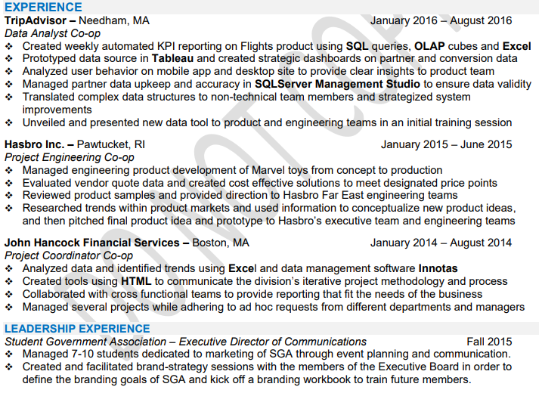
Resume Section:
Experience
Notes:
Show other examples on website:

Slide 11
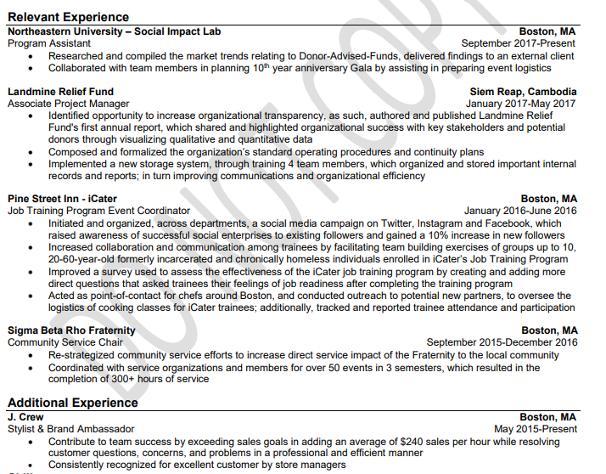
Resume Section:
Experience

Slide 12
Resume Section: Skills
Analytical Skills​
Computer Skills​
Cultural Awareness​
Decision Making​
Detail-Orientation
​Flexibility​
Independence​
Initiative​
Interpersonal Skills​
Leadership​
Problem Solving Skills​
Quantitative Skills​
Teamwork​
Organization
Verbal Communication​
Written Communication
High Quality Work​
Notes:
Ali
The aspects that you want to be sure to highlight may include one or many of these categories. Again, what you ultimately include on a resume would be dependent on the job you are applying to. A company may value certain qualities or qualifications differently depending on the requirements of the role and team.

Slide 13

Resume Section:
Skills
Not only technical - remember to include languages spoken!!
Create categories as it pertains to your major:
  Computer, Language, Programming, Tools, etc.
Notes:
Ali

Slide 14
Resume Section: References
Typically not included as part of your resume, but instead as a separate document when asked
Heading should match between Resume and References page
Notes:
Ali
Should also not write on your resume: References available upon request.

Slide 15

Using LinkedIn
Think of LinkedIn as an extension of your resume!
Be sure to include your experience abroad on this platform as well!
Notes:
Ali
For more information, attend our LinkedIn Workshops or come to the studio for 1-1 work on your profile.

Slide 16

Congratulations!
You have an interview!
Notes:
Ali
15min for interview section

Slide 17

Before the Interview
Do your research
Organization
Job
Individuals
Analyze job description and how your skills match
Prepare thoughtful questions
Practice, practice, practice!
Notes:
Diana:
When prepping for your interview, you want to think about these things:
1- highlighting at least 6 elements about yourself/skills/accomplishments to share with employer and also prepare at least 5-7 examples to demonstrate those skills and accomplishments.
2- a deeper research about the company to incorporate into your answers
3- knowing yourself and experiences well to be able to demonstrated how you are of a strong fit (similar to the resume process, with a deep understanding of how your skills translate well to the job description)- and it is through this process, that you can prepare thoughtful questions and responses.

Slide 18

The Importance of Research
Why?
Where?
  To gain knowledge of the company
  To be prepared to discuss skills and experience
  To be prepared to discuss career plans and goals
    Company’s Website
    Social Media
    Your Network
    Glassdoor
Notes:
Diana:
Point out that research includes not only the organization’s products/services, locations, etc. but also information on people at the organization, especially those they will be meeting. Check Google News or other sources to be up to date if the company has been in the news.
“Research” also includes asking for the names and titles of people who will be interviewing you and how long you should plan to be on site.
The reason why we are going over this overview of this process because it is important to think of your global experience as part of the value that you bring to the table at any given company/organization.

Slide 19
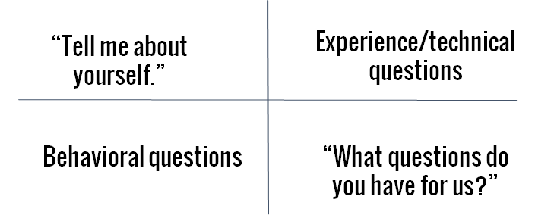
Interview Questions
Notes:
Diana:
So when you are asked these questions (read slide and many other questions) in an interview, you have those tasks, examples, skills, and results in mind to articulate your value add and speak confidently about it.

Slide 20
Practice Interview Questions
Common Questions
Tell me about yourself?
Why do you want this job/position?
What are your greatest strengths and weaknesses?
COVID-19 Questions
How did you stay productive while working from home (social distancing)?
How familiar are you with digital technologies? How did you use them to stay productive?
Behavioral Interview Questions
Tell me about a time when you demonstrated ______?
Teamwork Decision Making Persuasion
Communication Time Management Multitasking
Leadership Problem Solving Adaptability
Creativity Achievement Conflict Management
Notes:
Diana:
Make sure your responses give specific information and are positive representing yourself and other people. “Talking negatively or complaining about former employers. It shows lack of maturity and it shows the interviewer that the candidate could just as easily say the same things about their new employer. It's OK to talk about a "less than ideal situation," but never make yourself the victim or blame your former employer.”
“Tell me about yourself”: you want to describe a present situation, past experience and future aspirations in relation to the position and/or organization
“ What are your strengths?”: Start with strengths, make sure it’s in relation to the position/company. Give an example!
“what are your Weakness or an area of improvement : focus on something obvious or something you can “rebound” from – explain how you plan to overcome this weakness or the steps you’ve already taken to do so.
“why are you interested in the position?”: They’re testing you! Did you do your research? Show your passion for the work you anticipate doing as part of that company.
“what are some of your accomplishments?”: you can certainly talk about your global experience here as well to highlight the value. Just Be honest! If you can think of something that relates to the position, even better!
“Why should I hire you over the other applicants?”: This is your professional introduction! Think of what differentiates you from other candidates and leverages your accomplishments (experiences, global experiences, leadership, etc.).
“Is there anything you’d like to add”: This is similar to “why should I hire you?” However, you can use this to emphasize an outstanding accomplishment, to clarify a response to an earlier question, or reiterate your enthusiasm for the opportunity.
For example:
Strength: It’s not enough to just say you’re organized and detail oriented, prove it!
Weakness: Obvious: “as a Freshman I don’t have a ton of professional experience”
“rebound” from “I am a natural helper and I want to help with every project, I sometimes end up overwhelming myself. I am however very conscious of this and now before saying yes, I tell the person I just need to check my schedule. This has certainly helped a lot.”
Demo: https://careers.northeastern.edu/group/interviewing/

Slide 21
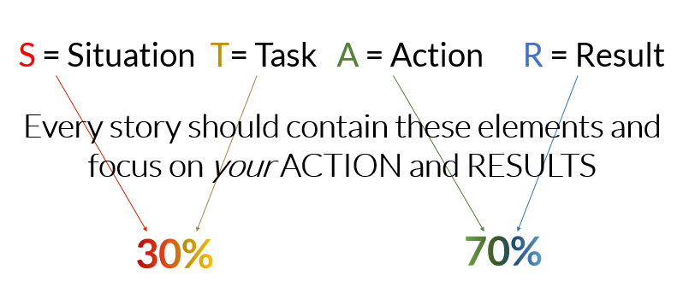
STAR Interview Method
Notes:
Diana
Demo: https://careers.northeastern.edu/article/interview-type-behavioral-and-situational/
This method that was mentioned earlier is going to be the same structure for answering your interview questions and as when writing your experiences on your resume.

Slide 22

Do You Have Any Questions for Us?
Ask about the company, department, position, or process
Notes:
Diana-
Possible questions to ask:
About the Company:
Is there a structured career path?
How would you describe the culture?
What do you like about working here?
About the Department:
What personal qualities do you value in an employee?
About the Position:
What would your ideal candidate be like for this position?
How will success in this position be measured?
Timeline:
Can you describe the rest of the hiring process?
When can I expect to hear from you about this opportunity?

Slide 24

Tips to Remember
Make sure you arrive on time- arrive at least 10-15 minutes early
Dress appropriately
Cell phone is off
Make appropriate eye contact
Give a firm confident handshake**
Sit up straight and don’t fidget
Avoid filler words and slang
Speak clearly and don’t rush
Notes:
Diana
Go over slide
**Make a connection

Slide 25

Notes:
Ali
Handout of student perspective-blurb to review and highlight skills gained.
Students have 10 minutes to review blurb and reflect on the type of experience they plan to have, the skills they anticipate learning and/or the skills they may want to learn while abroad. Write it down for themselves. Hear from 3-4 students if time permits.

Slide 26
During my time in India, I facilitated and oversaw the construction of two different roofs. Professionally, I learned and harnessed many skills to make my job possible. My boss was not always in India, so much of the work we did together was remote. We had a strong organizational system to use to make sure we were both on track with the work that needed to be done. Outside the office, much of the work that I did involve meeting locals and talking to them with the help of interpreters. To construct the roof, we had to negotiate with contractors, some of whom wanted to drastically increase the price of their work given that we were foreigners. Not everything was easy or like how it would be done in the U.S.
In terms of personal development, much of my work was done with the help of MHT, meaning that I had to establish a good relationship with my colleagues. As the only non-native in the office, I was able to build a rapport with my colleagues and become involved in the environment. Additionally, I had a great connection with my host family and traveled as much as I could. Together, we participated in ceremonies, and celebrated holidays. One thing I learned is the art of bargaining that required to understand the culture difference and be able to communicate.
Understanding the two different cultures of the Middle East and India, where I have lived, taught me the skill of identifying the needs of others I work with as well as developing a network of people. Working in India was really a life-changing experience for me, and I couldn’t recommend it enough!
Notes:
Review this summary of experience and highlight for yourself

Slide 27
My time in Bangalore was one of the most valuable educational experiences I have had during my university tenure. Although I had traveled before, and even lived in a different country, I had never been as far away as India. So much was new to me when I arrived. The pace of the city and the sheer amount of people around me took me by surprise. I had to adjust to not speaking the local language and to a very different set of social norms. The connections I ended up making with people I met there showed me that living anywhere in the world is a possibility for me and broadened my horizons. The initial culture shock I felt subsided when I met other young people who shared the same interests, passions, and dreams as me. I was lucky enough to travel around India with the friends I made, going from Rajasthan in the very north, to Kerala in the south.
While I was adjusting to a new city and culture, I was also getting used to working a full-time job as an intern at Smarter Dharma. The sense of independence I gained from navigating living on my own and the responsibility of employment cannot be overstated. I became much more confident in my own skills and resilience. Smarter Dharma was full of people who shared my passion for envisioning change and progress in our world. Through the policy work I did there I gained an entirely new perspective on how issues like climate change, government corruption, and more effect countries outside of my own. After spending five months in Bangalore at Smarter Dharma, I left a very different person from the one who came. I feel more confident than ever in my ability to adjust to news situations, norms, and people.
Notes:
Review this summary of experience and highlight for yourself

Slide 28


Introducing….
Notes:
Ali/Diana
Up to 20 min for employer speaker.

Slide 29

Where skills meet needs
www.bridgecultures.in
Unique forum that brings academic learning, cultural diversity and exposure to the world of entrepreneurship with a social lens to one place
Enable academic and social exchange for students through diverse sub-fields of social entrepreneurship
Focused on students’ learning journeys and growth through co-ops/internships and volunteer opportunities
We look for students who are
Open to move out of their comfort zone and value meaningful experiences
Receptive to diversity
Adaptive to change
Critical thinkers
Accountable
Initiators and self driven
Opportunities
Social entrepreneurship
Sustainability
Business and Communications
Engineering
Design and architecture
Research and Analytics
Public policy, political sciences
Humanities and social sciences
Notes:
Sanam

Slide 30
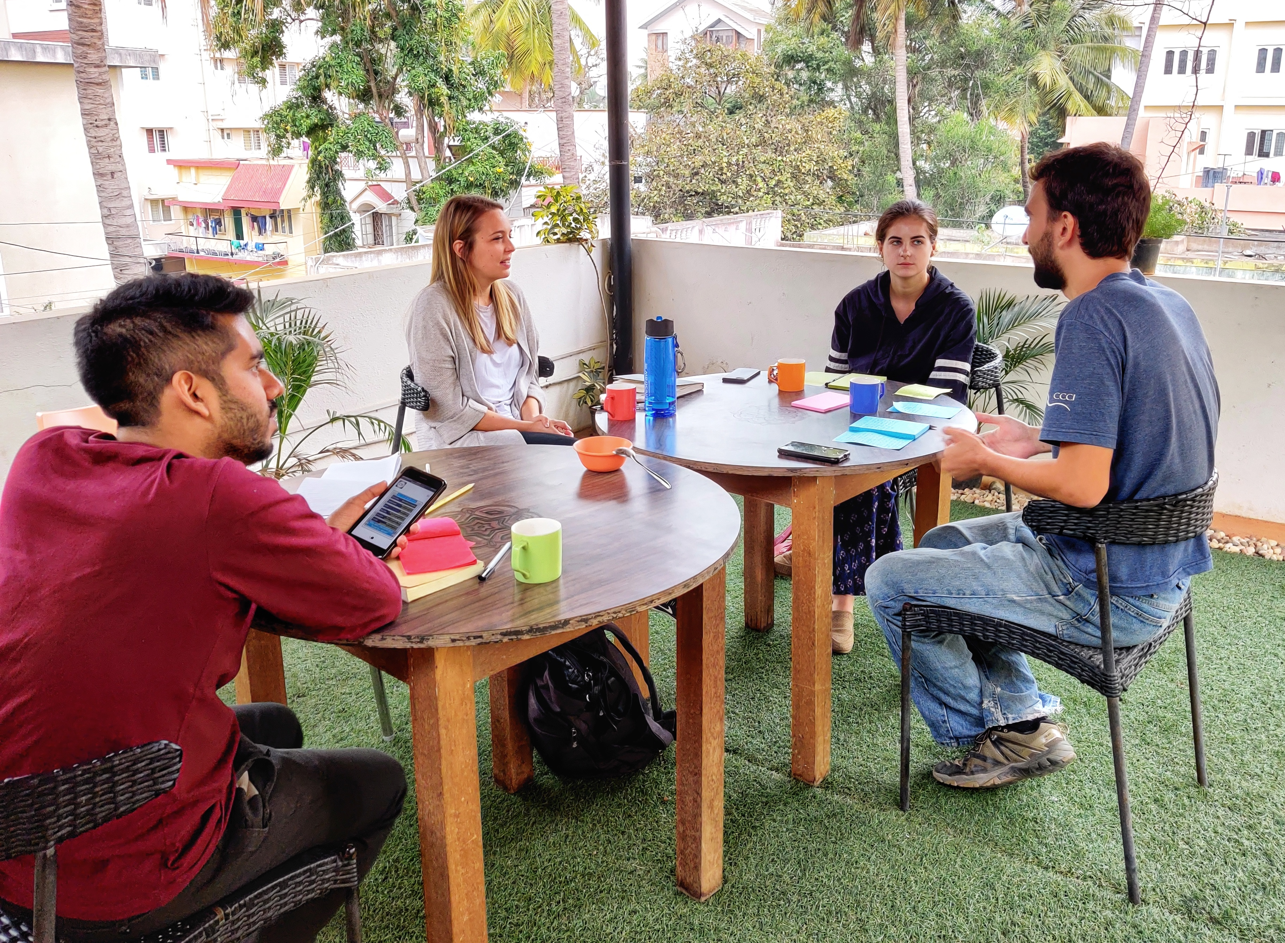
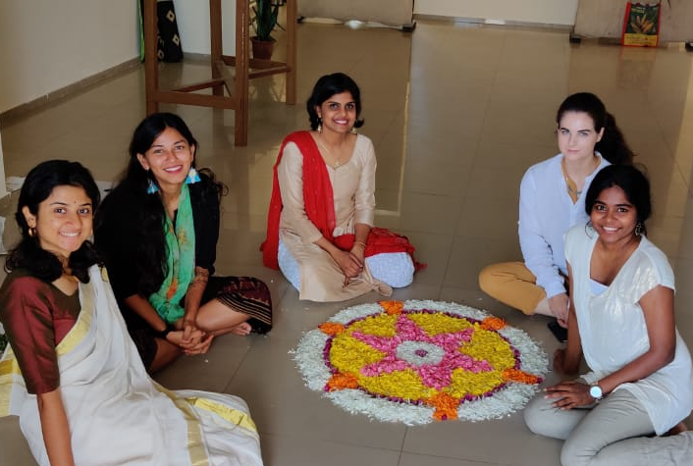
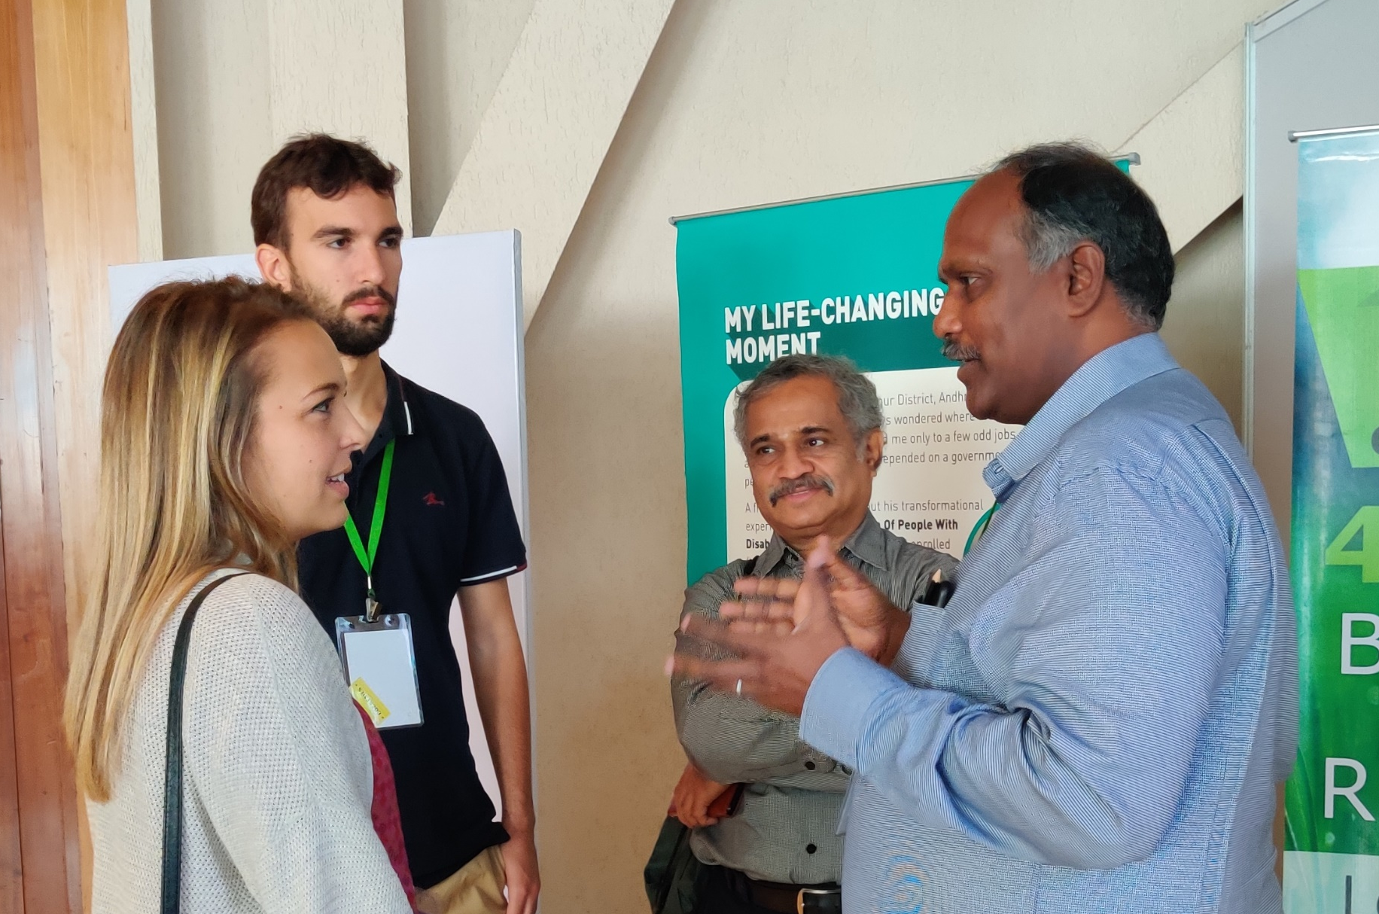
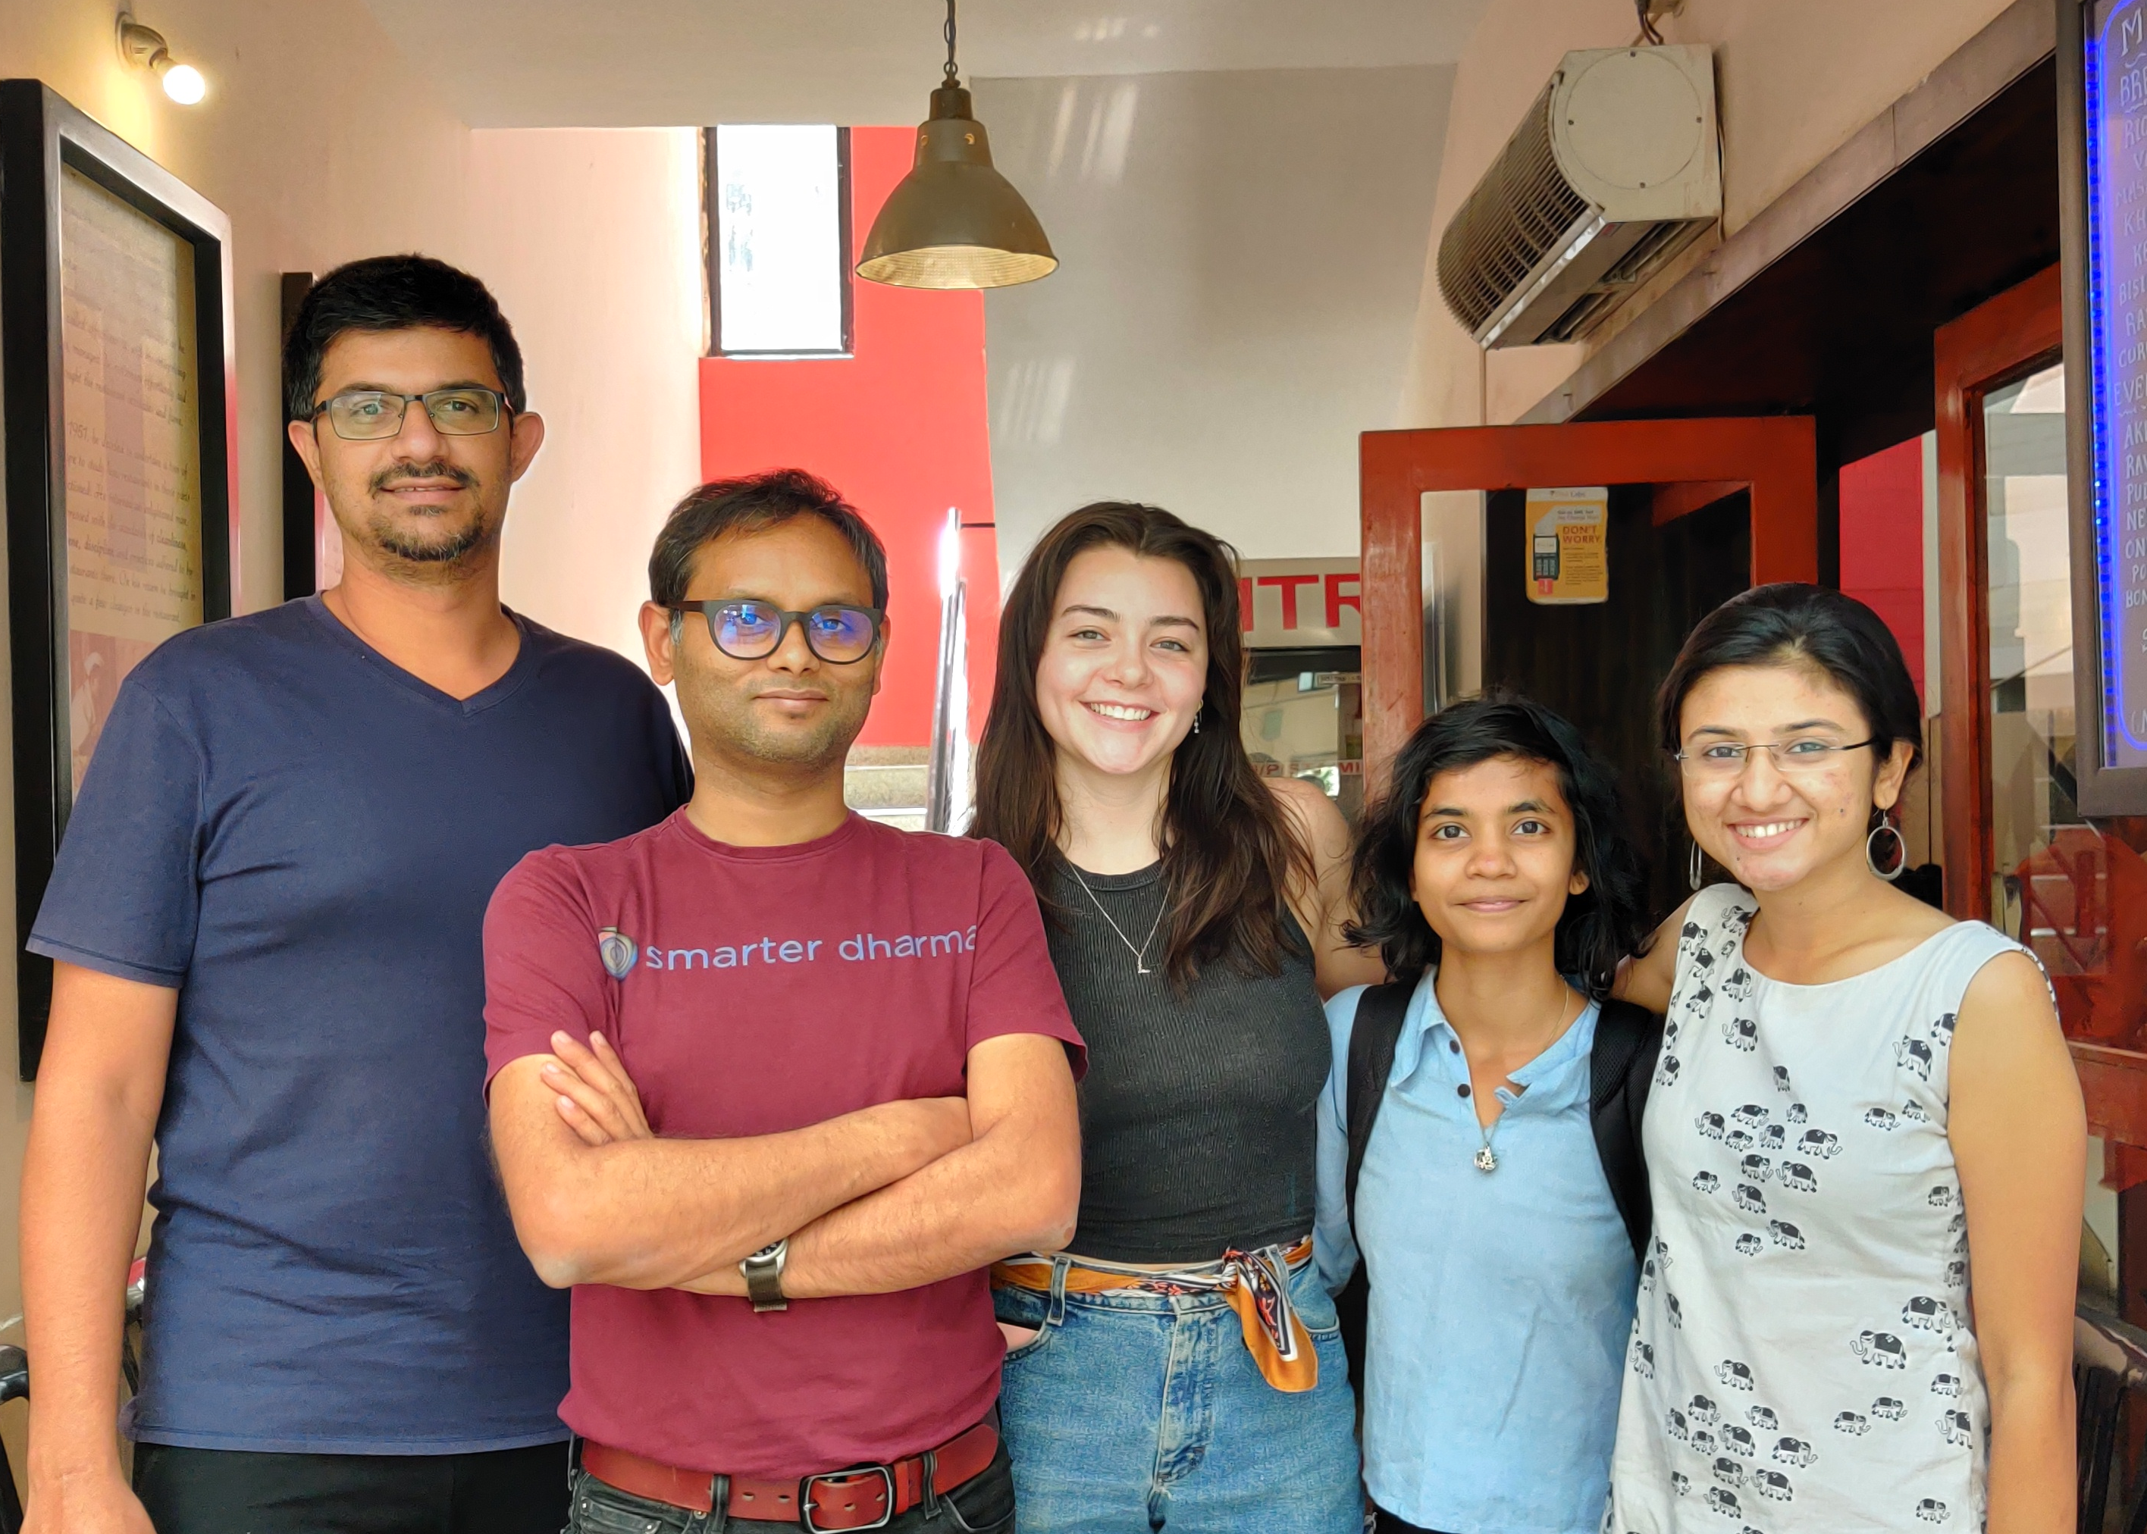
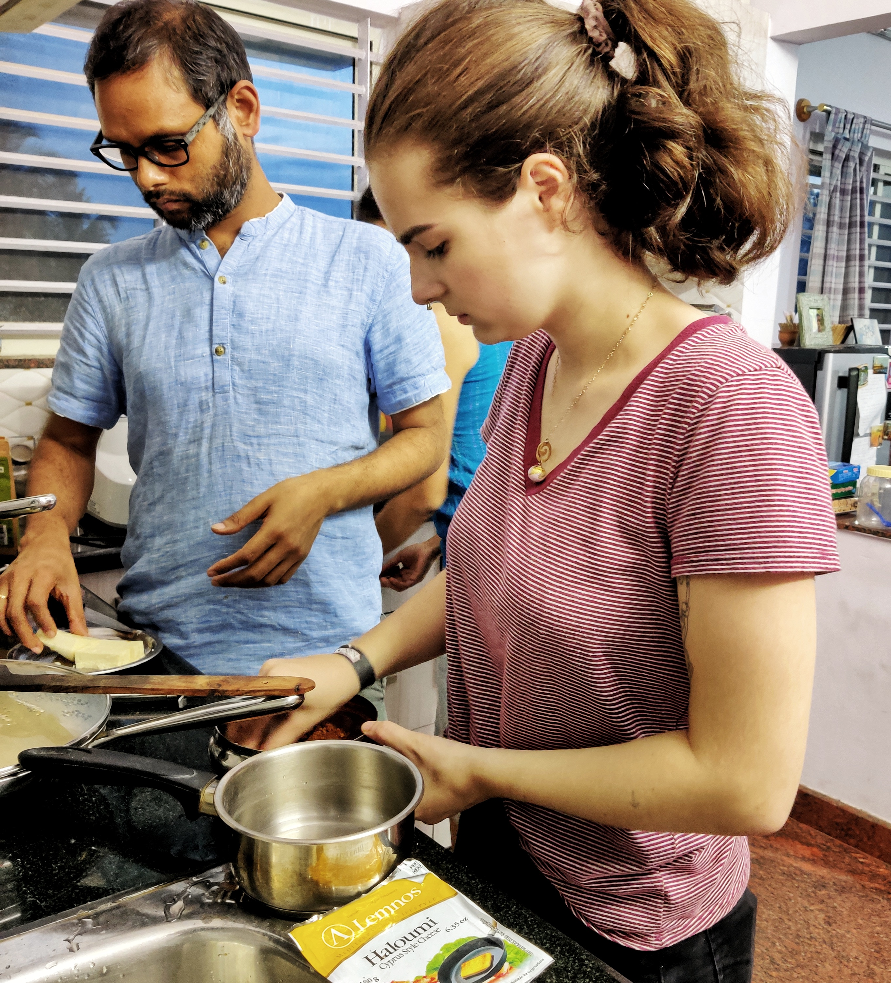
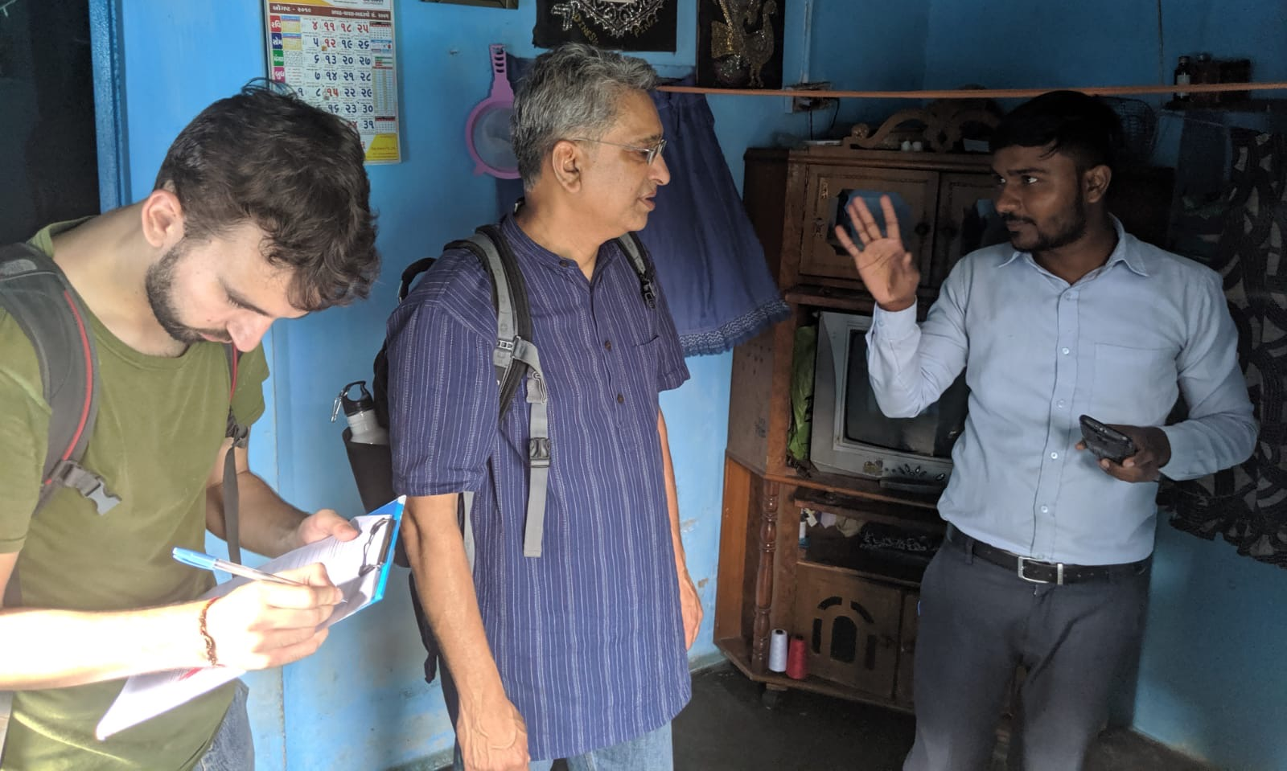
Where skills meet needs
www.bridgecultures.in
Notes:
Sanam

Slide 31
Notes:
Diana
Up to 10 minutes- 5min per question – 2 min per student for each question.
<20 students - 3-4 groups.
>20 students pair and share
Each group will pick 2 questions from the basket. - 1 per student, answer the question they pick and then switch if time permits

Slide 32
Practice Interview Questions
Common Questions
Tell me about yourself?
Why do you want this job/position?
What are your greatest strengths and weaknesses?
COVID-19 Questions
How did you stay productive while working from home (social distancing)?
How familiar are you with digital technologies? How did you use them to stay productive?
Behavioral Interview Questions
Tell me about a time when you demonstrated ______?
Teamwork Decision Making Persuasion
Communication Time Management Multitasking
Leadership Problem Solving Adaptability
Creativity Achievement Conflict Management
Notes:
“Tell me about yourself”: you want to describe a present situation, past experience and future aspirations in relation to the position and/or organization
“ What are your strengths?”: Start with strengths, make sure it’s in relation to the position/company. Give an example!
“what are your Weakness or an area of improvement : focus on something obvious or something you can “rebound” from – explain how you plan to overcome this weakness or the steps you’ve already taken to do so.
“why are you interested in the position?”: They’re testing you! Did you do your research? Show your passion for the work you anticipate doing as part of that company.
“what are some of your accomplishments?”: you can certainly talk about your global experience here as well to highlight the value. Just Be honest! If you can think of something that relates to the position, even better!
“Why should I hire you over the other applicants?”: This is your professional introduction! Think of what differentiates you from other candidates and leverages your accomplishments (experiences, global experiences, leadership, etc.).
“Is there anything you’d like to add”: This is similar to “why should I hire you?” However, you can use this to emphasize an outstanding accomplishment, to clarify a response to an earlier question, or reiterate your enthusiasm for the opportunity.

Slide 33

Self-Authored Integrated Learning (SAIL): A Key Tool
Know Your “I” and Why ↔ Self Knowledge Drives Your Choices. The SAIL framework can help you identify both competencies and skills you may need to develop further.
Explore and Experience ↔ Testing Yields New Data. SAIL has a great opportunity finder.
Tell Your Story ↔ A Unique Profile Helps You Stand Out. SAIL’s MyStory function can help.
Navigate Your Networks ↔ Relationships Bring Both Jobs and Joy. SAIL is also a useful networking tool.
Reflect and Recalibrate ↔ Integrative Learning Powers Your Next Move. Once again, SAIL can help.
  Learn this process and you will engage it repeatedly throughout your lifelong journey.
  No matter what twists and turns lie ahead, you will be in the driver’s seat!
Notes:
Notes: If you haven’t downloaded the SAIL app, I encourage you to do so now! It’s a great tool to log and track your on-campus experiences. Trust me when I say, it’s always worth taking time to reflect on your experiences soon after they happen instead of months or a year later when you need to recall specific information. If you have it downloaded, I encourage you to open it now and if you are in the process of downloading, when you’re ready..
Login to SAIL Northeastern, Student Experience
Use MyStory to connect learning from workshops, classes, jobs, and co-ops to foundational masteries that match your developing career goals. It could be a workshop like this one, a class, or any other experience you have that is associated with NU. It allows you to take charge of your own learning and gives you great language and terminology to describe your experiences in a way anyone would understand because it uses common terms for different competencies within each dimension. SAIL fits in with every part of career design – from understanding yourself or “Finding Your Why” to telling your story all the way through to reflecting and recalibrating.
Take charge of your learning by engaging with activities related to selected Dimensions of Holistic Growth
Use SAIL terminology to communicate your experiences/competencies

Slide 34
Next Steps
&
Resources
Understanding and articulating your global experience can be key in making yourself stand out as a candidate.
List here as they pertain to the topic
Other campus partner sites
Check out our Coaching Labs and Drop In Schedule
NUworks for Events
SAIL Moments
What are your next steps?
Share ONE action you will complete after today’s session to advance your goals.
Notes:
Notes: In addition to the resources we discussed today, check out the variety of other resources found on our website, careers.northeastern.edu in addition to our other coaching labs and Career Studio for drop-ins M,R,F 1:30-4:30pm and T/W 1:30-7pm eastern time. Be sure to check out what else is happening on campus in SAIL and in NUworks as well!
Next Steps:
Reinforce the ‘tagline’ or takeaway of the coaching lab.
What are your next steps?
In the chat, put one thing you’re going to do sometime after today’s session to work towards your goals.
Resources:
Remember, there are a ton of resources available to you through Northeastern and beyond. Be sure to tap into services to help you along the way – they are all here for you!
Review any new resources you haven’t gone over during the lab.
Thank you again for joining today’s session and we hope to see you again soon!

Slide 35

Notes:
All
Staff, Employer and Students stay until 2pm to answer any individual questions.

