Slide 1
Introduction to Global Co-op Spring & Summer 2022
Hosted by Global Co-op Coordinators,
Kristina Kutsukos & Mary Carney
September 21st, 2021

Slide 2
Introductions
Mary Carney
Senior Co-op Coordinator
Bouve College of Health Sciences
Kristina Kutsukos
Assistant Global Co-op Coordinator
College of Engineering
We’re excited to have you exploring global co-ops for Spring & Summer 2022!

Slide 3
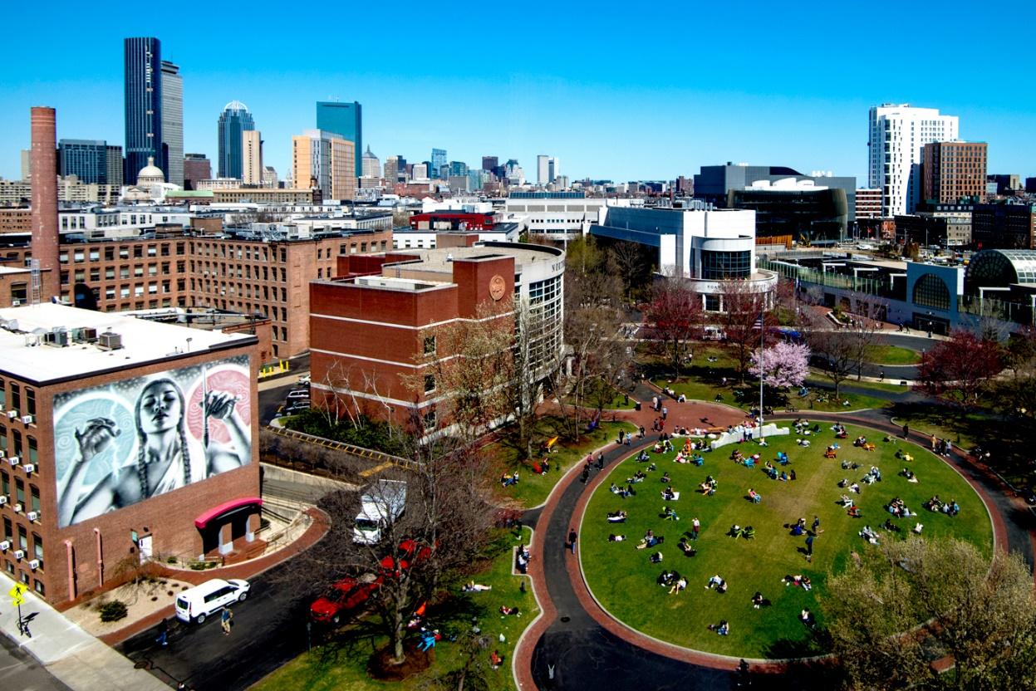
Agenda
Why Global Co-op?
International Travel & Safety
Global Co-op Opportunities
Student Panel
Questions

Slide 4
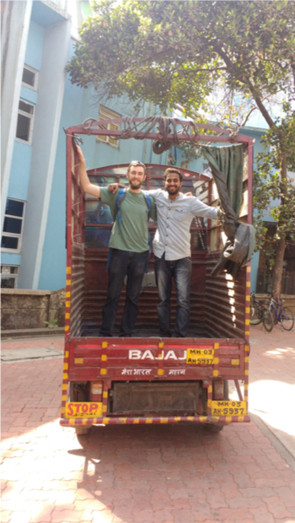
Why Global Co-op?
Gain global/intercultural competence
Explore the world
Learn to practice languages
Skills in leadership and management of diverse teams
Marketability for future co-op and full-time employment – employers like to see this kind of experience!
International experience is the norm in many companies worldwide
Notes:
SC

Slide 5
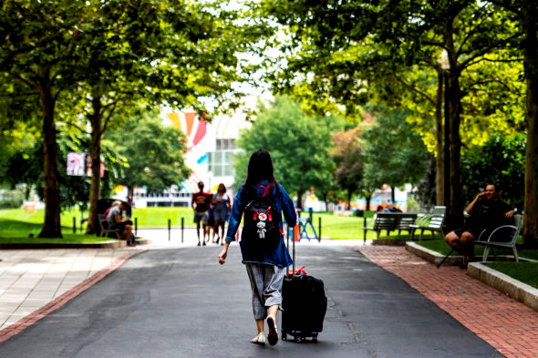
International Travel & Safety
Step 1: Global Feasibility Check
The feasibility check considers your health, safety, and global dynamics
Step 2: Global Petition (Students will need to demonstrate the following):
Compelling reason for travel
Ability to travel/enter country
Preparedness/In-country support
Resilience to disruptions
Step 3: Stay Flexible!
There may be unexpected changes, whether COVID-19 related or not
Students should prepare a Plan A, Plan B, and perhaps a Plan C
The University, and your co-op coordinator, are here to support the best learning opportunities within co-op- there are clear processes in place for you to make a decision that is right for you!

Slide 6
Global Co-op Opportunities
3 Categories of Global Co-ops
Onsite Global
Hybrid Global
Home Country

Slide 7
Global Co-op Opportunities - #1 Onsite Global Co-ops
Immersive Experience: This option provides the chance to be on-site and to have the 24/7 cultural experience of working abroad
Research Required: You will need to do research to determine if/where this may be possible
Back-up Plan: Regulations and travel plans may change quickly due to Covid-19 or other factors
Be prepared to shift to remote work with the same organization or have other options as backup

Slide 8
Global Co-op Opportunities - #2 Hybrid Global Co-ops
Remote/hybrid Immersion: Opportunity to experience a new culture without "fully" integrating. Great opportunity for:
Students who want to work with companies in a global location where travel isn't possible
Students who have not traveled abroad before but want global experience
Limit Risk of Travel: This option provides the chance to be working remotely without the element of international travel during a pandemic
Fewer Logistics: Don't need to go through an international petition process, secure housing/ visa/ transportation in another location

Slide 9
Global Co-op Opportunities - #3 Home Country Co-ops
Network: This option provides a chance to network and gain work experience in your home country/region
Limit Risk of Travel: This option provides the chance to be working close to home without the element of international travel during a pandemic
Fewer Logistics: Don't need to go through an international petition process (Acknowledgement of Risk form only), secure housing/ visa/ transportation in a foreign location

Slide 10
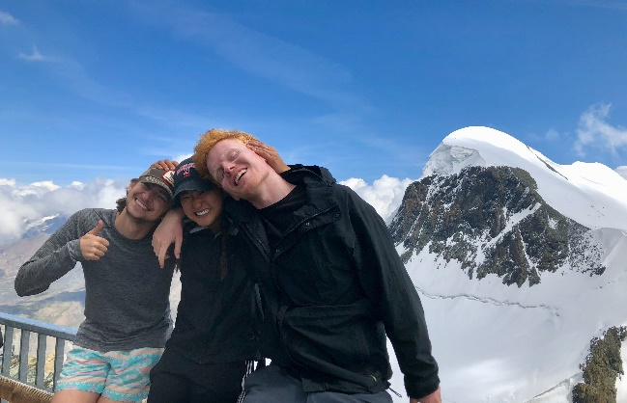
Self-Developing a Global Co-op
Niche industries
Specific locations
Network within country of citizenship
Expands number of opportunities
Practice for post-graduation job search
AJ self-developed in Switzerland
Lexi self-developed in Germany
Notes:
Look for unique opportunities outside NUworks

Slide 11
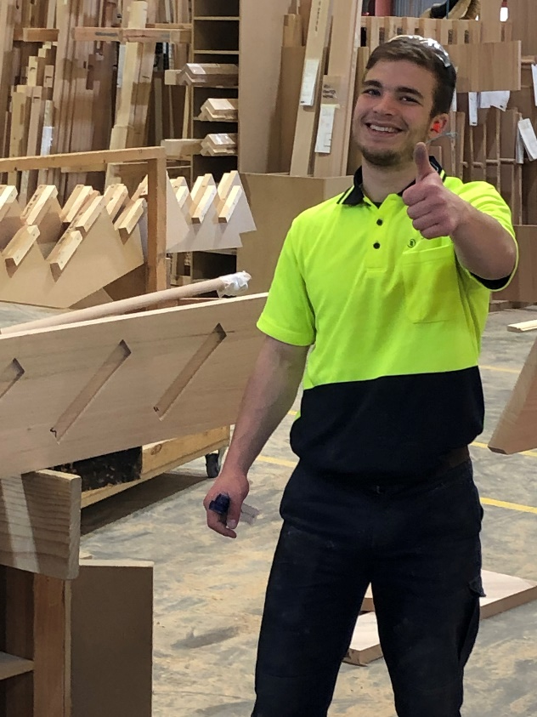
Self-Developing: Getting Started
You may be connected in ways you don’t realize!
Multinational companies you are interested in might have global offices
Look online for global branches and job postings of internships
Personal connections- Family, Friends, Professors
Alumni outreach- LinkedIn!
Online
Indeed, Monster, AngelList [startups], StepStone
GoinGlobal
Google “internships” and then country name
Chase self-developed in Australia
Notes:
SC

Slide 12
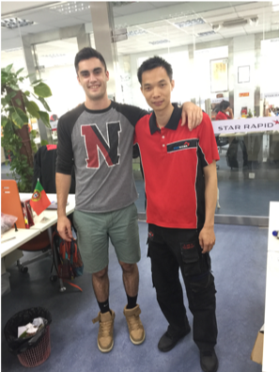
Next Steps
For all students who are eligible for Spring/ Summer 1 2022 co-op:
Schedule an appointment to meet with your co-op coordinator assigned within your college
Each college has different requirements regarding co-op eligibility, so be sure to discuss this with your co-op coordinator/ college directly
Apply for global positions in Nuworks and/ or look into self-developing
Apply for the Presidential Global Scholarship and/ or Honors Scholarship!
Notes:
KK

Slide 13
Agencies Fair

Slide 14
Questions?

Slide 15
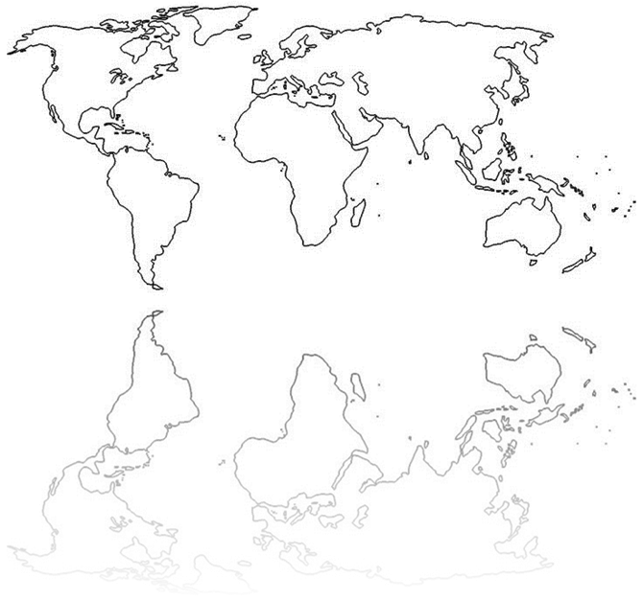
Follow Global Co-op on Social Media!
Northeastern Global Co-op
nuglobalcoop
@NUglobalcoop
globalco-op
Notes:
KK

